Slide 1
Real time Analysis of new York Traffic Tickets
Saikiran kancharla
Deepak Chandramouli
Ragu Subbaian

Slide 2





DATA PIPELINE
DATA
COLLECT
PROCESS
STORE
ANALYZE

Slide 3
OVERVIEW OF THE DATA
Contains 4 most recent years of New York Traffic Citations Data.
Contains 11 fields like state_of_license, court, violation_dow, violation_year, age_at_violation, violation_month, source, violation_charged_code, gender, police_agency, violation_description.
Used API endpoint https://data.ny.gov/resource/q4hy-kbtf.json to stream the data to Kafka using Kafka-python producer.

Slide 4
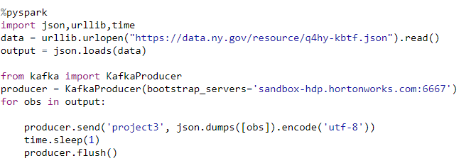
KAFKA PRODUCER
Installed Kafka-Python using pip
Utilized Kafka-Python to Create a Kafka producer and streamed the data to the Kafka Topic as shown below

Slide 5
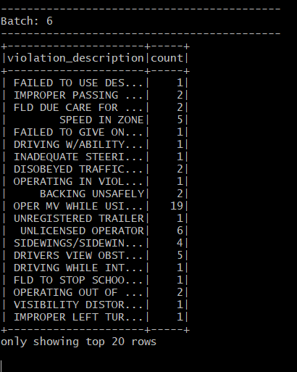
Consuming and Processing The DATA
Used Spark structured Streaming to do the processing of the Data.
Executed python file to stream the data
Explored following questions
Violation reasons (Why)
Violations by Region/Borough (Where)
Violation by Gender and Age group (Who)
Violations by day/month (When)
Wrote the data to HDFS

Slide 6
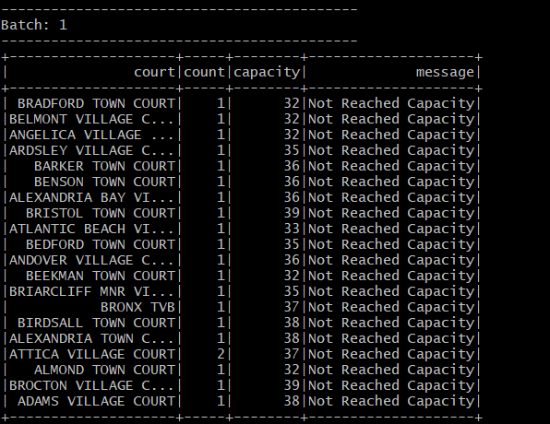
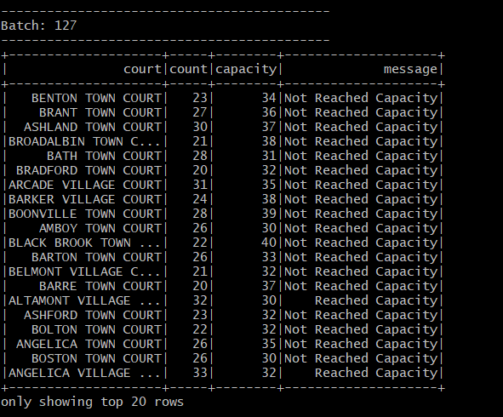
REAL TIME ALLOCATION OF TICKETS BASED ON COURT’S CAPACITY
Explored a use case to determine the real time allocation of cases by court
Created static Spark Dataframe containing the capacities of the court
Joined with real time stream to determine if the tickets issued is greater than the capacity and make it available to the officers issuing the citation to route it to the lower capacity courts

Slide 7
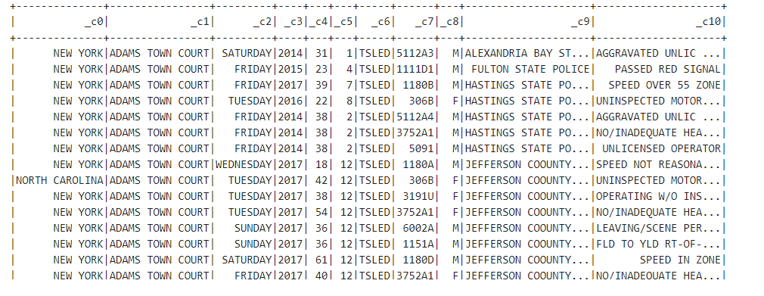
Combine Structured Streaming Small Files
Combined small files created by spark structures streaming to create one file.
Read this file into hive for further analysis.
allfiles = spark.read.option("header","false").csv("/tmp/project12/*.csv")

Slide 8
Challenges FACED
Considerable amount of time creating kafka producer and streaming the data
Difficulty in inferring the Schema for the json data
Limited Resources on open source version of Kafka-connect

